Slide 1
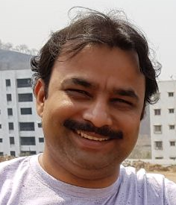
Prerequisites - To Get Started
Pravinkumar R .D.

Slide 2


Tools and Software

